Slide 1
Armed Forces Covenant and Service Children
Vikki Barr
Armed Forces Covenant Partnership Officer
Notes:
Julie Intro and explanation – intro re SCISS conference – very complex area!
Vikki intro and back ground.

Slide 2
The Armed Forces Covenant
The Covenant is a promise between the nation, the government and the MOD, ensuring that those who serve and have served in the Armed Forces, and their families, are treated fairly and are not disadvantaged by their service.
About - Armed Forces Covenant
Local Covenant Partnerships are tasked to deliver on this promise.
In Northants, we have 25 organisations on the partnership all working together across the county.
Notes:
VB go through, play video – need to embed video from home PC.
Service children can access a wider support services then civilian community but we have to identify and signpost. CEAS/MKC heroes/ reading forces – tools for schools to use as well.

Slide 3
Northamptonshire’s pledges in respect of Children and Education
5.5 Education
Work with the Department of Children and Young People (DCYP) and the Local Authorities to determine the numbers and location of the children of serving personnel (regular and reservist), as well as dependent young people, to include Early Years and Children’s Centres.
Ensure that schools are aware of the Service Pupil Premium and are claiming all that they are entitled to. Determine ways in which Pupil Premium is spent and identify and share areas of good practice.
Work with schools and local providers to identify where Service personnel’s children might require additional support to help them deal with a parent being away from home for long periods of time, often in conflict situations. Children in some Service families may be considered more vulnerable than the general population because of the pressures they face, including PTSD.
Ensure that policies enable a smooth transition for children from Forces families, alleviating any issues that may be experienced finding a school place mid-term, when a serving parent has been transferred to a new area of the UK; assist when issues arise at any other time relating to finding a school place for a dependent child.
Notes:
Pledge signed June 2018 – need to ensure we are keeping to the commitment. Give brief overview

Slide 4
Covenant Project
Website
Training
Engagement and awareness
MOD Liaison
Grant Funded
Notes:
Brief – website, training for teachers – ilearn, 90 minute face to face, online modules November, all free whilst MOD paying, VB can go out and do training at staff meetings.
Resources pages on the website

Slide 5
Life in the Military
Regular serving, reservists and their families
Unique way of life – not just a job.
Supportive and tight knit community – hard if a dispersed family
Deployment/Mobility/Weekending.
Postings are an ORDER
Different Language and humour
Lack of understanding by civilian community
Last minute changes due to operational needs, military comes first
Transition – Military to Civilian
Repetition/gaps in education
Issues with SEND
Progression to Further Education/Higher Education
Mental Health and Wellbeing issues for all the family
Notes:
Overview of life in military. Transition, forced moves, never at right time. No option, control of taken out of a families hand.

Slide 6
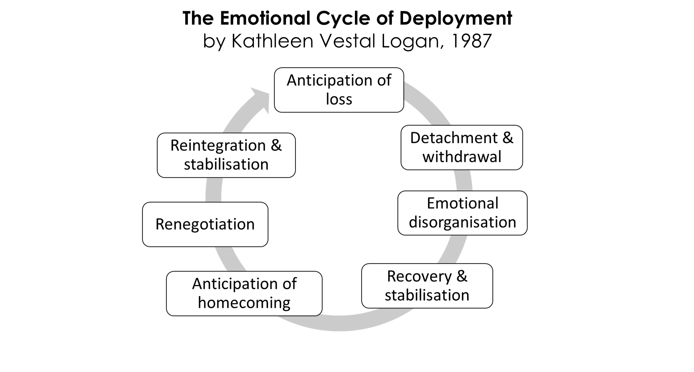
Notes:
Period of deployment is longer than just the 6 months away. Constant cycle for some where regular deployments happen. Solihull approach. Effects of RnR. Potential effect on unstable families - maternal mental health issues, children with disabilities. Increased vulnerability increases effects of deployment/mobility.

Slide 7
Service Pupil Premium
Funding from the MOD for every service child. Applies to divorced and bereaved families too.
It is not means tested.
Calculated from school census data so vital that a child is registered as a service child at the school.
Only 50% take up of those that can claim so schools need to encourage parents to confidentially state that they are military family in order that they receive the funding.
Northants Covenant officer can provide posters to put up at schools.
Can continue for up to six years after serving person leaves the forces as long as it was claimed for at least 6 months prior to leaving.
Best practice guides in resources.
Should be used for pastoral support and to support progression where there have been gaps in education.
Notes:
Ofsted/childrens commissioner report/ not always claimed so will be more military kids than we are aware of. Veteran and reservist don’t appear in the data. – need to ask the question.

Slide 8
Further Education for Service Children
Higher proportion of service children are young carers and this can affect whether those children attend further education.
Higher mobility often results in disillusion for schooling and aspirations to continue on with further education
Various types of funding is available to support children into further education – see resource page
Regular engagement with the individual is key. Each persons experience of military life is different. Children are often resilient and strong but there is very much a ‘brave face’ mentality across the whole military family.
Engage with families federations and support such as military kids club heroes to ensure a supportive peer group within school particularly if you only have a few military children.

Slide 9
Support and Resources
AFC Northamptonshire – www.afcnorthamptonshire.co.uk
RBL best practice guide - https://www.britishlegion.org.uk/get-involved/campaign/support-for-service-children/
Gov.uk - https://www.gov.uk/government/publications/the-service-pupil-premium
Covenant Factsheet - https://www.armedforcescovenant.gov.uk/wp-content/uploads/2017/12/7-Things-you-need-to-know-about-Service-Pupil-Premium-factsheet.pdf
SCIP alliance - https://www.scipalliance.org/assets/files/Service-Pupil-Premium-key-information.pdf
SCISS - https://www.scipalliance.org/about/partners/service-children-in-state-schools
Little Troopers - http://www.littletroopers.net/
Reading Force - https://www.readingforce.org.uk/
Military Kids Club Heroes - https://www.britishlegion.org.uk/remembrance/schools-learning/mkc-heroes/
DCYP/CEAS - https://www.gov.uk/government/groups/directorate-children-and-young-people
https://www.gov.uk/guidance/childrens-education-advisory-service
Children's Commissioner - https://www.childrenscommissioner.gov.uk/

Slide 10
Contact Details
Vikki Barr
Armed Forces Covenant Partnership Officer
Northamptonshire County Council
Work: Vbarr@Northamptonshire.gov.uk
Tel: 07912891735
Web address: www.afcnorthamptonshire.co.uk
Email: covenant@northamptonshire.gov.uk

